Slide 1

Introduction to Counting Return Records in PHP
This presentation will guide you through the process of counting return records in PHP. We will cover various techniques and strategies for achieving this task, along with practical examples.
SV
by Sowmiya Vijayan

Slide 2
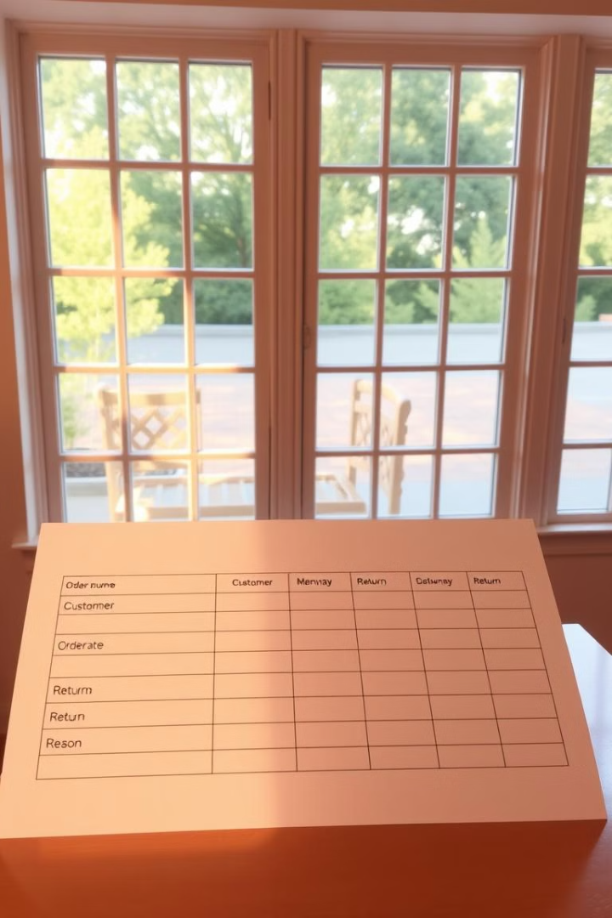
Understanding Return Records
Return records capture information about items that are returned by customers. These records can include details such as the return date, reason for return, and customer information.
Product Defects
Incorrect Orders
Customers may return items due to manufacturing defects or damage.
Customers may receive the wrong items, leading to returns.
Size/Fit Issues
Change of Mind
Clothing or footwear may not fit properly.
Customers may simply decide they don't want the item anymore.

Slide 3

Importance of Tracking Return Records
Tracking return records provides valuable insights into customer behavior and product quality. This data can be used to identify areas for improvement and optimize business operations.
1
Customer Satisfaction
2
Product Quality
High return rates may indicate customer dissatisfaction with products or services.
Frequent returns due to defects can highlight quality control issues.
3
Inventory Management
4
Financial Impact
Accurate tracking of returns helps manage inventory levels and prevent stockouts.
Returns can significantly impact profitability, so understanding trends is crucial.

Slide 4
Techniques for Counting Return Records
Several techniques can be used to count return records in PHP, each with its strengths and weaknesses. Choosing the right technique depends on your specific needs and data structure.
Database Queries
Array Iteration
File Processing
Utilize SQL queries to filter and count relevant records directly from the database.
Loop through an array of return records, incrementing a counter for each record.
Read data from a file containing return records and count them line by line.

Slide 5
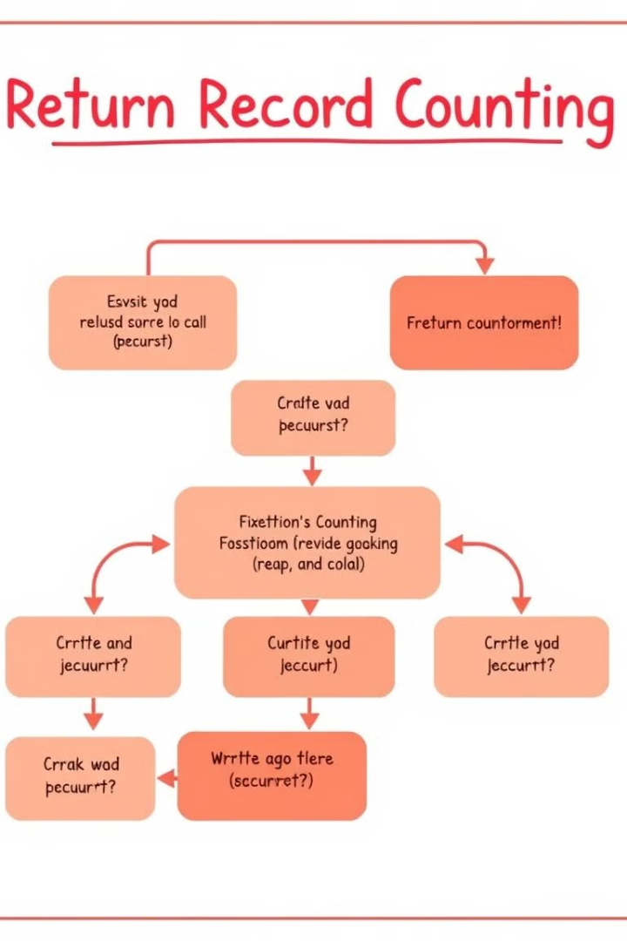
Implementing a Return Record Counting System
The implementation involves defining clear data structures, writing PHP functions to count records, and integrating with your existing database or data source.
1
Data Structure
Decide how you will represent return records. Consider a database table or an array of objects.
2
PHP Functions
Create functions to retrieve, filter, and count return records based on your criteria.
3
Integration
Integrate your counting system with your existing infrastructure to ensure seamless data flow.

Slide 6
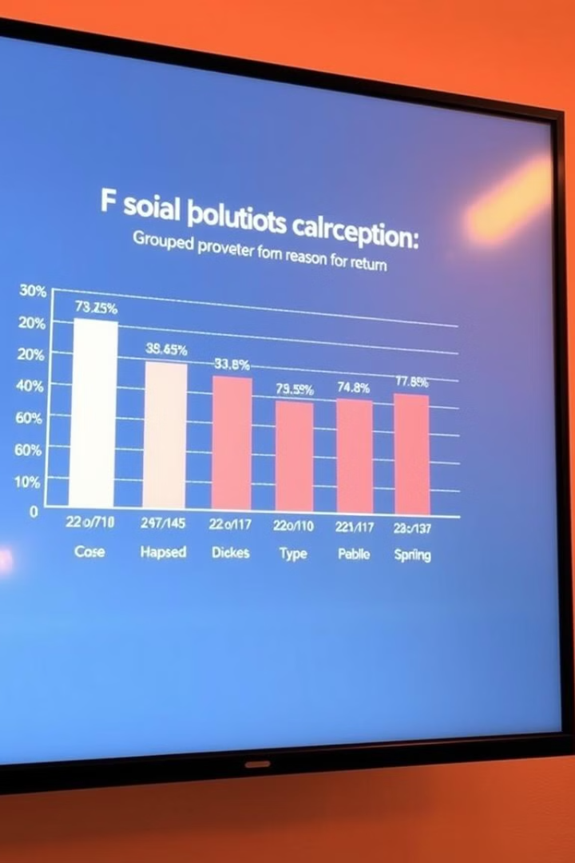
Analyzing Return Record Data
Once you have collected and counted return records, analyzing the data is crucial to derive meaningful insights and identify areas for improvement.
Reason for Return
Count
Product Defect
100
Incorrect Order
50
Size/Fit Issue
75
Change of Mind
25

Slide 7




Optimizing Return Record Counting Processes
Optimizing your return record counting processes can lead to faster execution times and improved performance, allowing you to gain insights more quickly.
Caching
Indexing
Code Optimization
Store frequently accessed data in memory for quicker retrieval.
Create indexes on database tables for faster data retrieval.
Streamline your PHP code for efficiency and reduce unnecessary computations.

Slide 8




Conclusion and Key Takeaways
Counting return records in PHP is essential for businesses of all sizes. By implementing an efficient system and analyzing the data, you can gain valuable insights, improve customer satisfaction, and optimize business operations.
Data-Driven Decisions
Use data to make informed decisions about product improvements and customer service.
Process Optimization
Streamline your return handling processes to reduce costs and improve efficiency.
Customer Focus
Understand customer needs and address their concerns effectively.

